Slide 1
MEDICAL SOCIAL MEDIA TEXT CLASSIFICATION
BASED ON IMPROVED CAPSULE NETWORK

Slide 2
CONTENTS
Abstract
Introduction
Literature Survey
Existing System
Proposed System
System Specifications
Modules

Slide 3
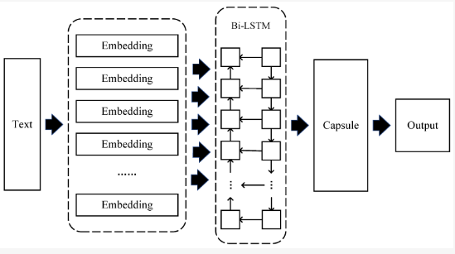

ABSTRACT
In the medical field, Text Classification is based on Natural Language Process (NLP).
Capsule Network model for electronic medical record classification is proposed.
It relies on a unique routing structure to extract complex Chinese medical text features.

Slide 4
INTRODUCTION

Slide 5
LITERATURE SURVEY

Slide 6
Existing system

Slide 7
Proposed system

Slide 8
System specifications

Slide 9
modules

